Slide 1

By USBee

Slide 2
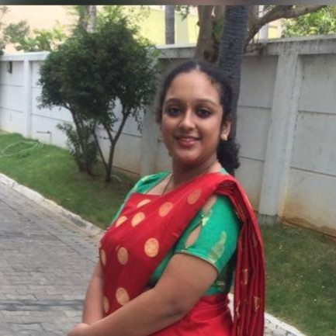
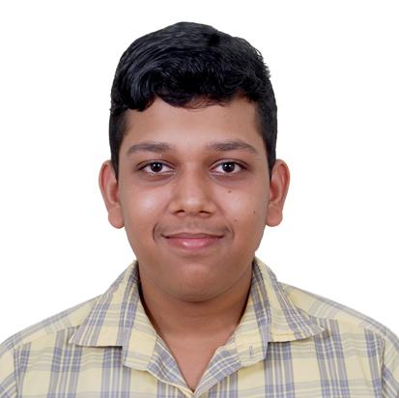
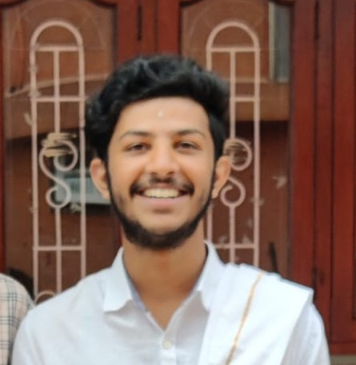
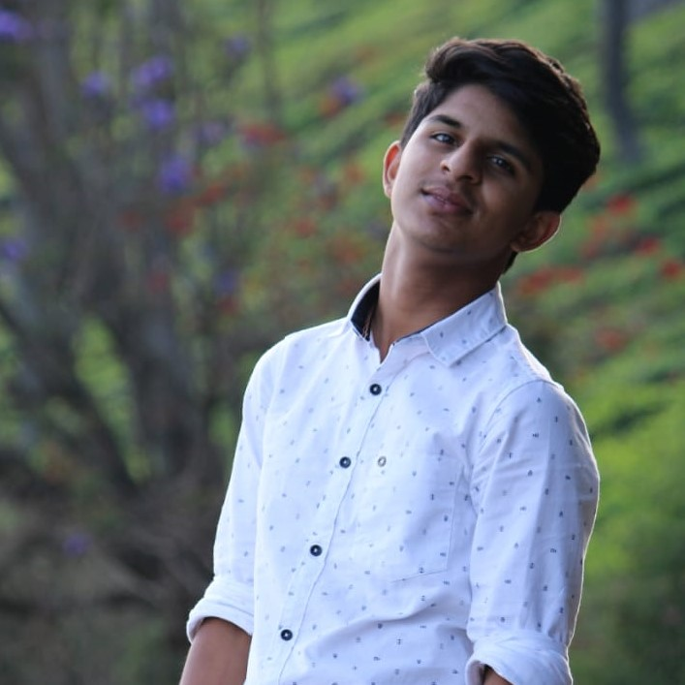
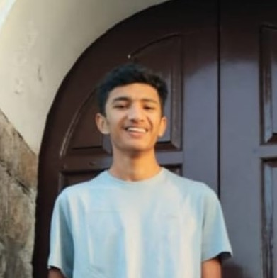
USBee
A TEAM FASHIONED FOR FLOURISHING GREEN FARMING
Navadeesh
Sunil Kishore
Yashu Venkat
Sneha Janarthanan
Siddhesh
Agarwal
Public speaker, efficient team lead, creative thinker and content writer.
Proficient with Python, HTML5, CSS3 along with several libraries and frameworks. Authored 2 Python Libraries.
Neophyte in the field of front-end development. Inquisitive about technology!
Amature in front-end development. Tenderfoot in GitHub. Expert in working as a team.
Efficient team coordinator, creative thinker and content designer.

Slide 3
Crop Disease Identification:
Create an application that can help farmers in identifying plant diseases and solving them.

Slide 4
Our
Solution
Curated List of Diseases
Curated List of Pests
Diagnostic Test for Disease Identification
Scanner for Disease Identification
Crisis Aversion Page

Slide 5
Agricultural knowledge is generally passed down in families through generations.
Now more than ever, people are quitting day jobs to pursue agriculture, and it is important that we encourage this endeavour.
But, These individuals have little to no source of this valuable generational knowledge.
This knowledge gap can prevent these individuals from moving to agriculture.
Why Now ?

Slide 6
We at ProLeafic believe that bridging the gap between idea and execution, lies in the delivery of information.
So, we catered this web application towards millennials who would like to take the leap between desk jobs and farming.
Hence, this web application is chock full of modern and innovative solutions to the problems that novice farmers may face
But, come as second nature to seasoned farmers with generational know-how.
Why ProLeafic?

Slide 7
Plant at peace!
https://github.com/Siddhesh-Agarwal/ProLeafic

